Slide 1
Use Case Documents by
Nkenta Uchechukwu Ferdinand

Slide 2
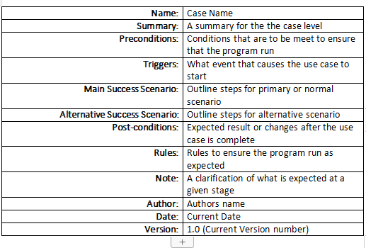
Use Case Document Sample (Template)

Slide 3
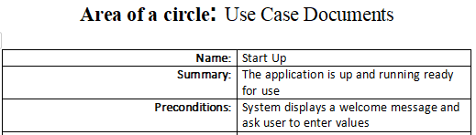
Name, Summary, Precondition
Name: Here a unique name describing the functionality is keyed in.
Summary: This is a high level description of the use case
Precondtion: This are condtions that are meet before the use case can start. This can be as start the car before it can move.

Slide 4

Triggers, Main Success Scenario, Alternative Success Scenario
Triggers: This handles the event that makes the use case to be initiated
Main Success Scenario: Outlines steps for the primaru or normal scenario
Alternative Success Scenario: Outline the steps for secondary or alternative scenario

Slide 5
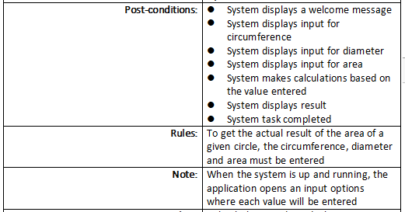
Post-Condition, Rules, Note
Post-Condition: This shows and tells what happens when a use case ends.
Rules: This are conditions that are to be meet or followed in other to get the program run as expected
Note: This are additional info descripting what to be done what to look out for during when the program is running.

Slide 6

Author, Date, Version
Author: Name of the person who wrote the programme and perherps running it
Date: When each task is performed
Version: Current version of the program. This can as well change based on when the program is updated.

